Slide 1

Cancer
Lesson 2.3
How do cells normally act as part of a community, and become isolated in cancer?

Slide 2
Do Now
  This morning at breakfast, you cut yourself while slicing an apple. What happens inside the cut that heals the wound?
  (Hint: Think more about cell reproduction and less about immune system)

Slide 3
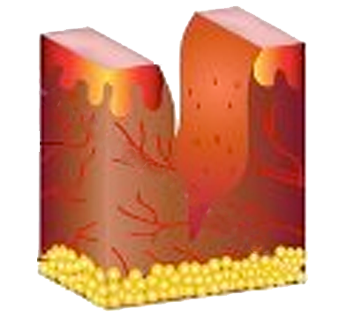
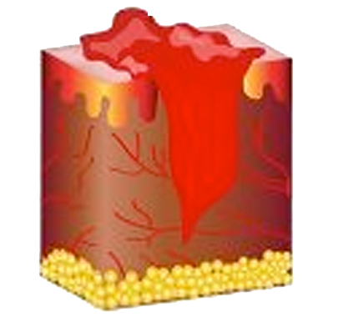
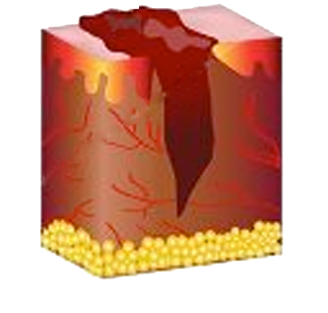
Cell proliferation during wound healing
3) The blood forms
a scab.
1) The wound is made.
2) It fills with blood
containing platelets.
4) The platelets secrete
a growth factor.

Slide 4
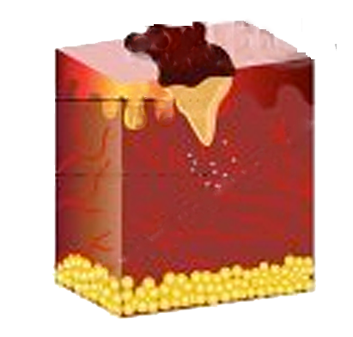
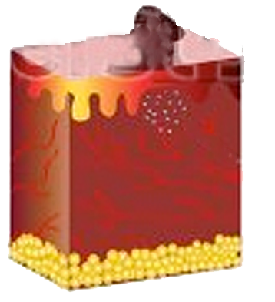
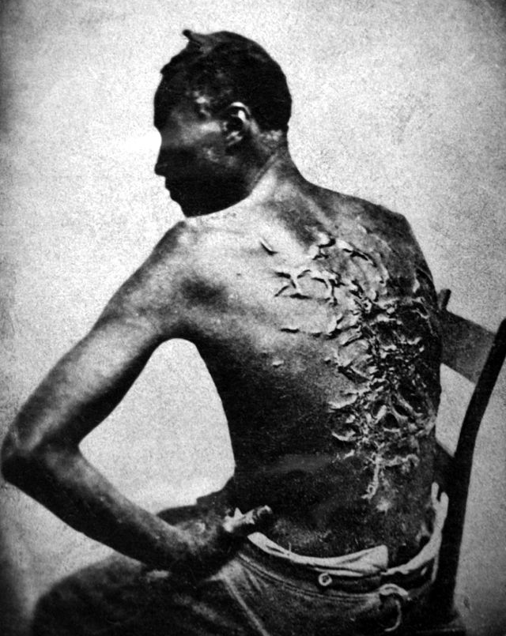
Cell proliferation during wound healing
7) Contact between epithelial cells stops them proliferating. The wound is healed!
5) The growth factor stimulates stromal cells to proliferate.
6) The stromal cells release a growth factor that stimulates epithelial cells to proliferate.

Slide 5

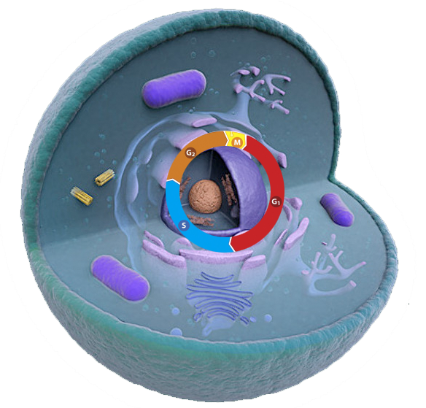

But, how do signals from the cell’s environment affect proliferation?
Divide!!
Don’t divide!!

Slide 6
Proteins in the membrane respond to the extracellular signals
Divide!!
They are called receptors – each recognizes its own signal

Slide 7
The signals activate the receptors
Divide!!
The receptors transmit information to the nucleus

Slide 8

The transcription factors act on genes
Transcription factors activate gene transcription

Slide 9
‘Go’ signals stimulate transcription of growth genes
Transcription factors activate gene transcription

Slide 10
‘Stop’ signals stimulate transcription of stop-growth genes
Transcription factors activate gene transcription

Slide 11
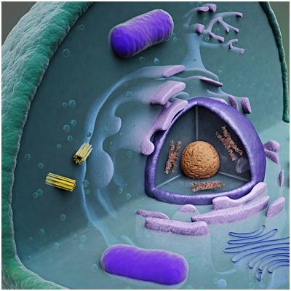
A closer look at the signaling ‘chain reaction’ in stromal cells
1) The platelets secrete a growth factor called PDGF (platelet-derived growth factor).
Inside a stromal cell in a wound
2) PDGF binds to its receptor on the stromal cell membrane and activates it.

Slide 12
A three-step signaling chain reaction
1. The PDGF receptor activates a
transduction protein - TP
2. The TP activates a
Transcription factor - TF
TP
TF
3. The TF passes into the nucleus

Slide 13
How signaling affects proliferation
1. If the signal from PDGF is present in G1 phase
2. The TP is activated
TP
3. The TP activates the TF
factor for G1 driver genes
TF
4. More G1 driver proteins are made
D

Slide 14
Resting state of epithelium
Outside
Wnt Receptor
Cytoplasm
T.P.
T.F.
G1 driver gene
Nucleus

Slide 15
Pro-growth signaling from stroma to epithelium
Wnt
Outside
Wnt Receptor
Cytoplasm
TP
T.F.
Nucleus
G1 driver gene

Slide 16
Stopping the epithelium proliferating
Anti-growth signaling through
contact inhibition
Cytoplasm
T
T
Outside
Contact receptor
Wnt Receptor
(Cadherin)
(Frizzled)
T.P.
Cytoplasm
(GSK-3)
T.P.
(Beta-catenin)
T.F.
G1 driver gene
Nucleus

Slide 17
Activity:
Explore ways to disrupt the contact inhibition pathway:
What happens when you mutate genes in the contact inhibition pathway model?
What happens when you mutate genes in the global cell signaling model?

Slide 18
Wrap up: How contact inhibition changes cell proliferation
Death
Growth
Death
Growth
Death
Growth
Wounded tissue
90% Death
10% Growth
Healthy tissue
50% Death
50% Growth
Healing tissue
10% Death
90% Growth
OFF
Contact inhibition ON
OFF

Slide 19
How contact inhibition changes cell proliferation
Growth
Growth
Death
Growth
Death
Death
Tumor tissue
10% Death
90% Growth
Healthy tissue
50% Death
50% Growth
Healing tissue
10% Death
90% Growth
OFF
Contact inhibition ON
OFF

Slide 20
How mutations affect hyperproliferation
Growth
Growth
Death
Growth
Death
Death
Tumor tissue
90% Growth
10% Death
Healthy tissue
50% Growth
50% Death
Tumor tissue
90% Growth
10% Death
Oncogenes ON
Tumor suppressors OFF

Slide 21
Which mutations cause cells to hyperproliferate?
Any mutation in a pathway that leads to:
Overactive driver proteins (oncogenes).
Inactive tumor suppressors.

Slide 22
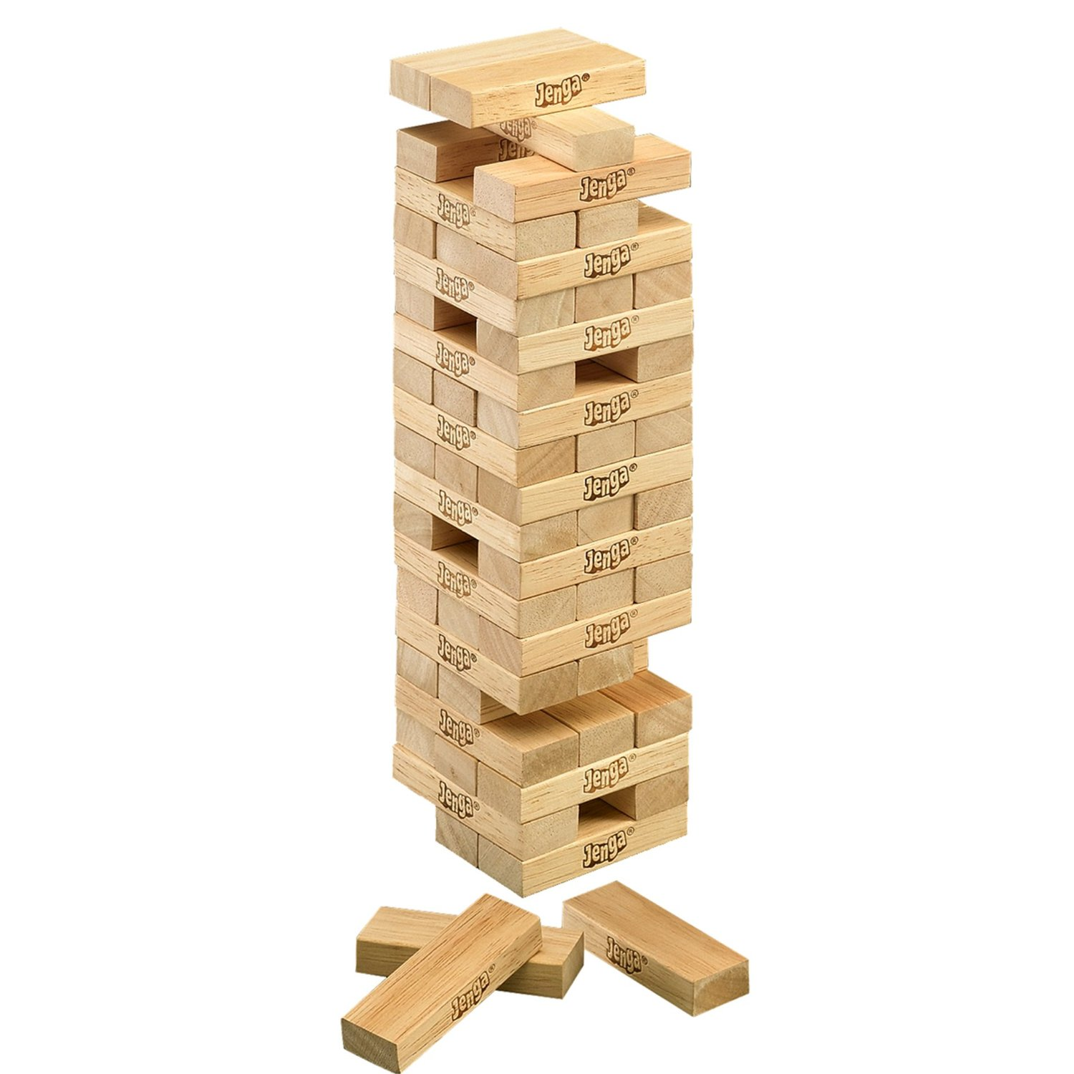
How many mutations?
A few key proteins are enough!

Slide 23
Homework
Students will read a short article about how cancer uses the wound healing pathway to metastasize.

